Slide 1
Chapter 18
CSE 3442
Tom Rethard

Slide 2
Intro - Keyboards
Most widely used I/O device
Two levels
  Architecture and workings of the keyboard per se
  Reading the keyboard from the CPU

Slide 3
Keyboard Architecture
Keys
  Organized into a matrix of rows and columns
  Usually a single microcontroller (ie, 1 chip)
    CPU
    RAM and EPROM
    Several Ports
    Determines which key was pressed and translates X-Y location to scan code

Slide 4
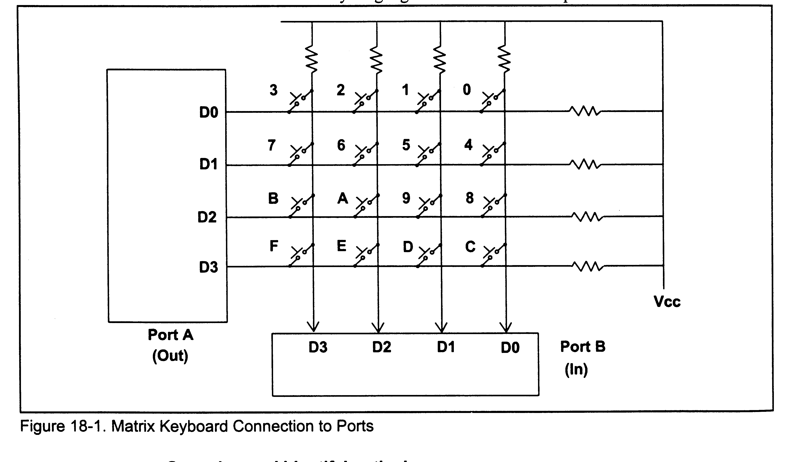
Matrix Keyboard Connections

Slide 5
Keyboard Scanning
Rows connected to an output serial port
Columns connected to an input serial port
If no key pressed, reading the input port gives b’1111’
  Connected to V_{CC}
If all rows are grounded and a key is pressed, one of the columns will have a 0

Slide 6
Keyboard Scanning (con’t)
To detect a key press:
  Ground all rows by providing 0 to the output latch
  Read columns
  Cycle through grounding rows to determine which key in the column was pressed

Slide 7
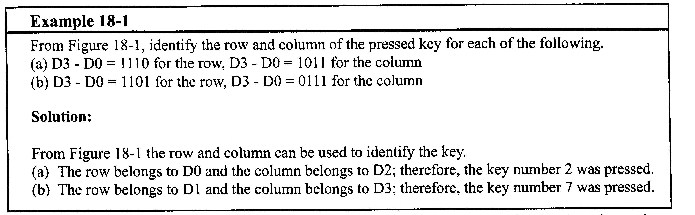
Example

Slide 8
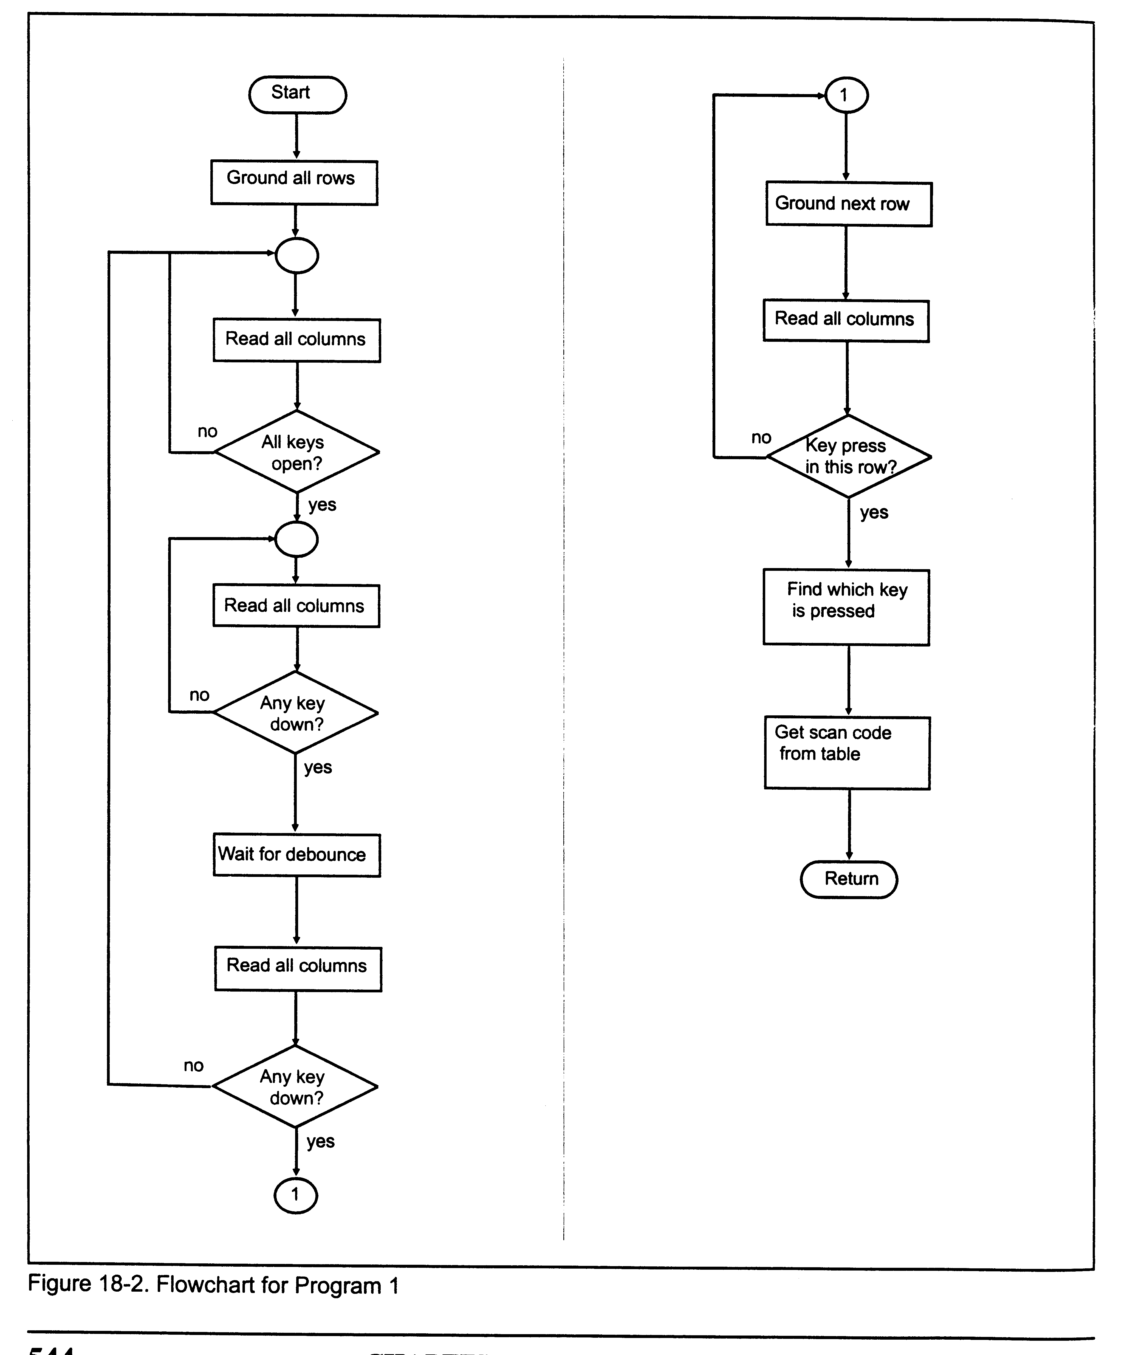
Flowchart

Slide 9
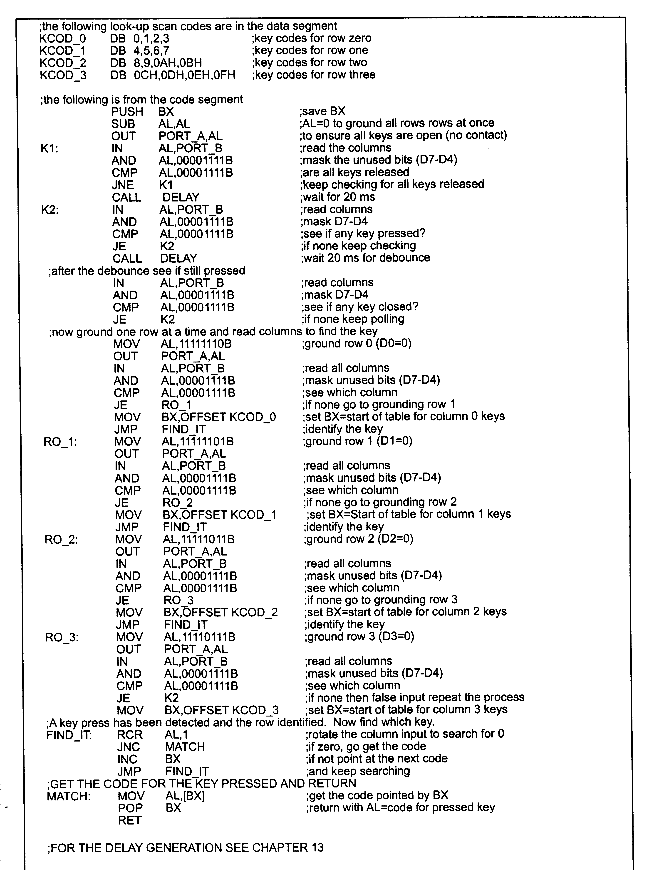
Program
An assembly program to read the rows and columns –
Runs on the keyboard

Slide 10
Keyboard Subtleties
How do you know you aren’t reading the same key?
  Output all 0’s to all rows and reread
  Continue until read all 1’s, the wait short time

Slide 11
Keyboard Subtleties (con’t)
How do you avoid noise causing a bad key to be read?
  “Debouncing”
  Wait 20ms after detecting the keypress and scan again.
  Real press is still available

Slide 12
Keyboard Subtleties (con’t)
How do you convert from row-column to scan code?
Data structures
  Table organized by row
  Can index into table based on row (base) using column as offset.

Slide 13
Keyboard Subtleties (con’t)
How do you determine which column the key is in?
  Usually by rotating the bits through the carry out until CF goes low

Slide 14
Keyboard Subtleties (con’t)
These processes can vary, depending on characteristics of the individual keyboard.
NatSemi MM74C923 is typical keyboard controller

Slide 15
Interfacing with the PC
IBM PC Keyboard
  Microcontroller for both detection and identification of keys
    Microprocessor (Intel 8042)
    Few hundred bytes of RAM
    Detachable
  Serial I/O to communicate with CPU

Slide 16
Keyboard Communications
Frame
  1 Start bit
  8 Data bits (scan code)
  Odd parity bit
  1 stop bit
74LS322 used as keyboard latch – also strips frame
  Presents to port A of the 8255 at 60H
  On later machines, the 74LS322 was replaced with another 8042, allowing bi-directional support
Notes:
Why bidirectional? For programmable keyboards

Slide 17
Scan Codes
IBM PC
  Represents key down and key up with two different scan codes.
    Make – key down code
    Break – key up code
      Always 127_{D} + Make scan code
      Ex: Make = X’06’, then Break = X’86’

Slide 18
Scan Codes
IBM PC
  Three major groupings (83 keys)
    Standard typewriter keys
    10 function keys
    15 key keypad
  Obviously, things have changed, since we now have 104 keys +

Slide 19
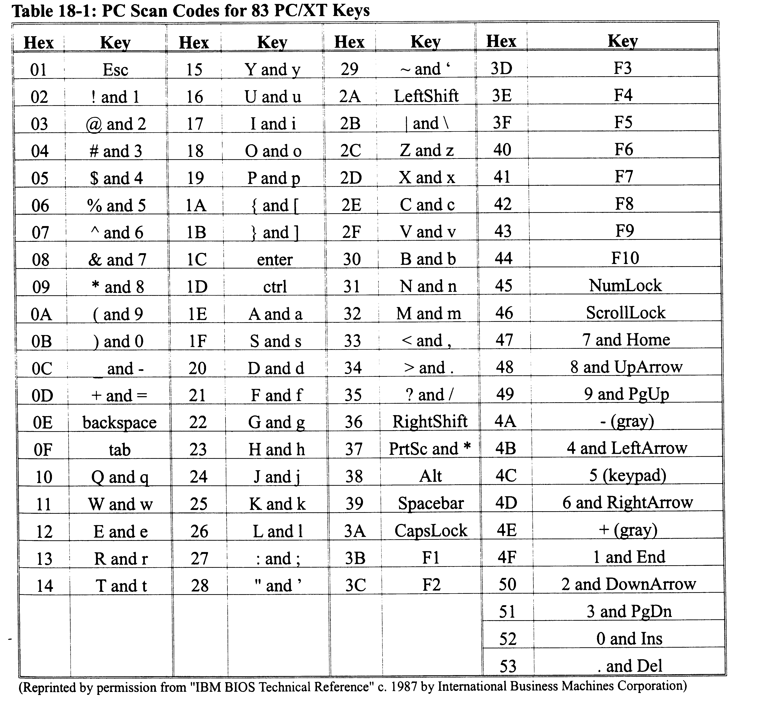
Scan Codes

Slide 20
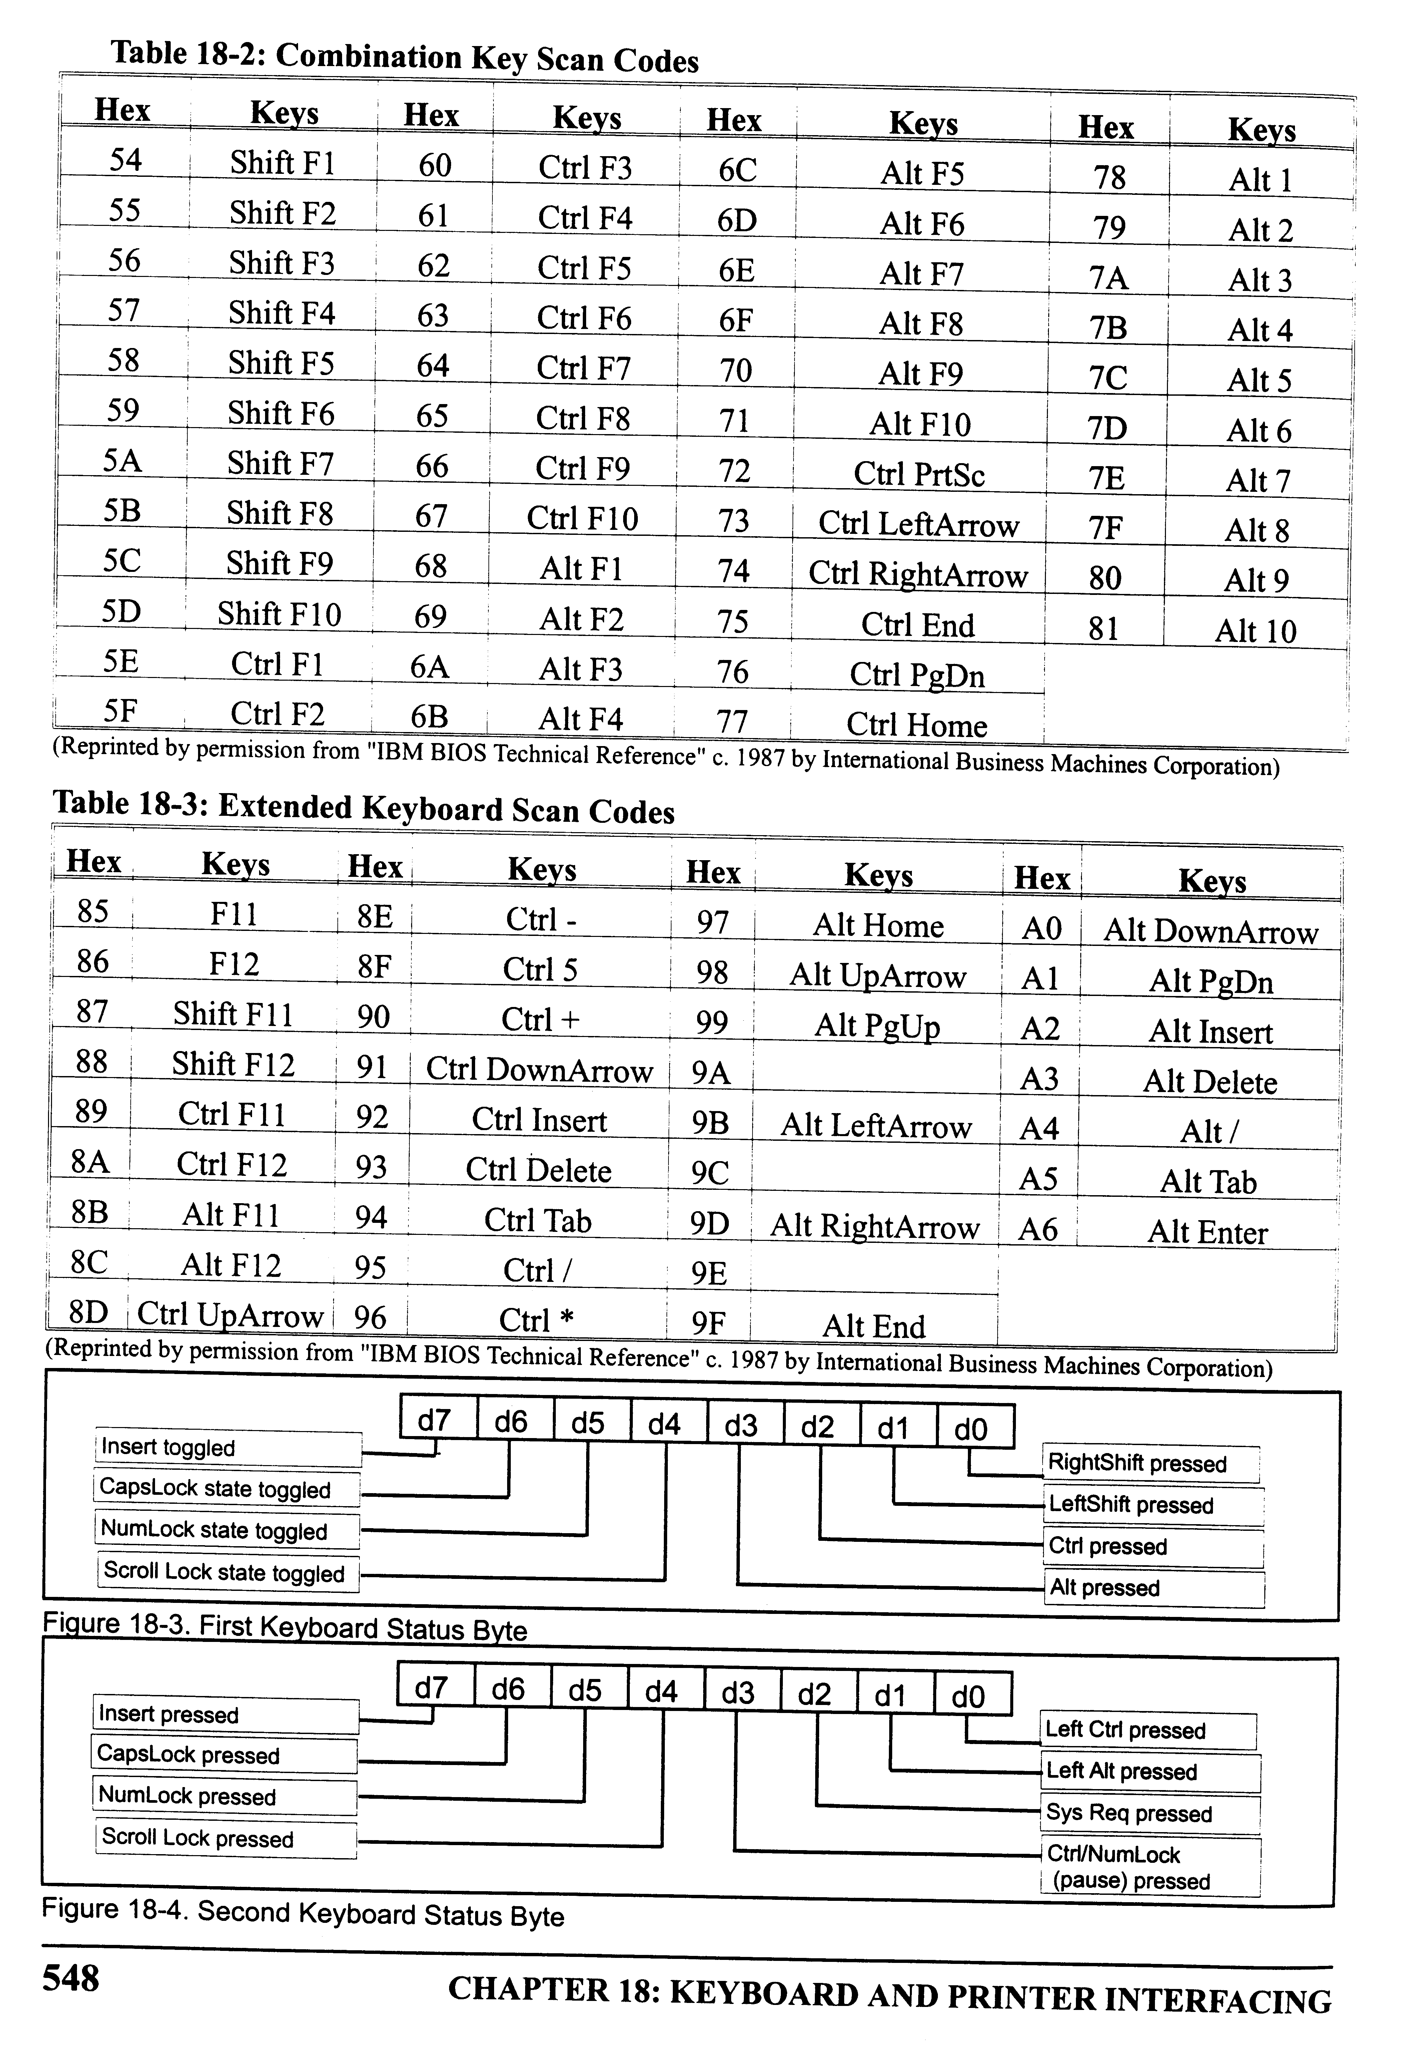
Extended Key Scan Codes

Slide 21
Combination Key Scan Codes

Slide 22
Shift Keys
How do you tell if a letter is upper or lower case?
  Shift Status Byte at 0040:0017H
  See fig. 18-3
Other control keys
  Shift Statue Byte at 0040:0018H
  See fig. 18-4

Slide 23
Combination Key Scan Codes

Slide 24
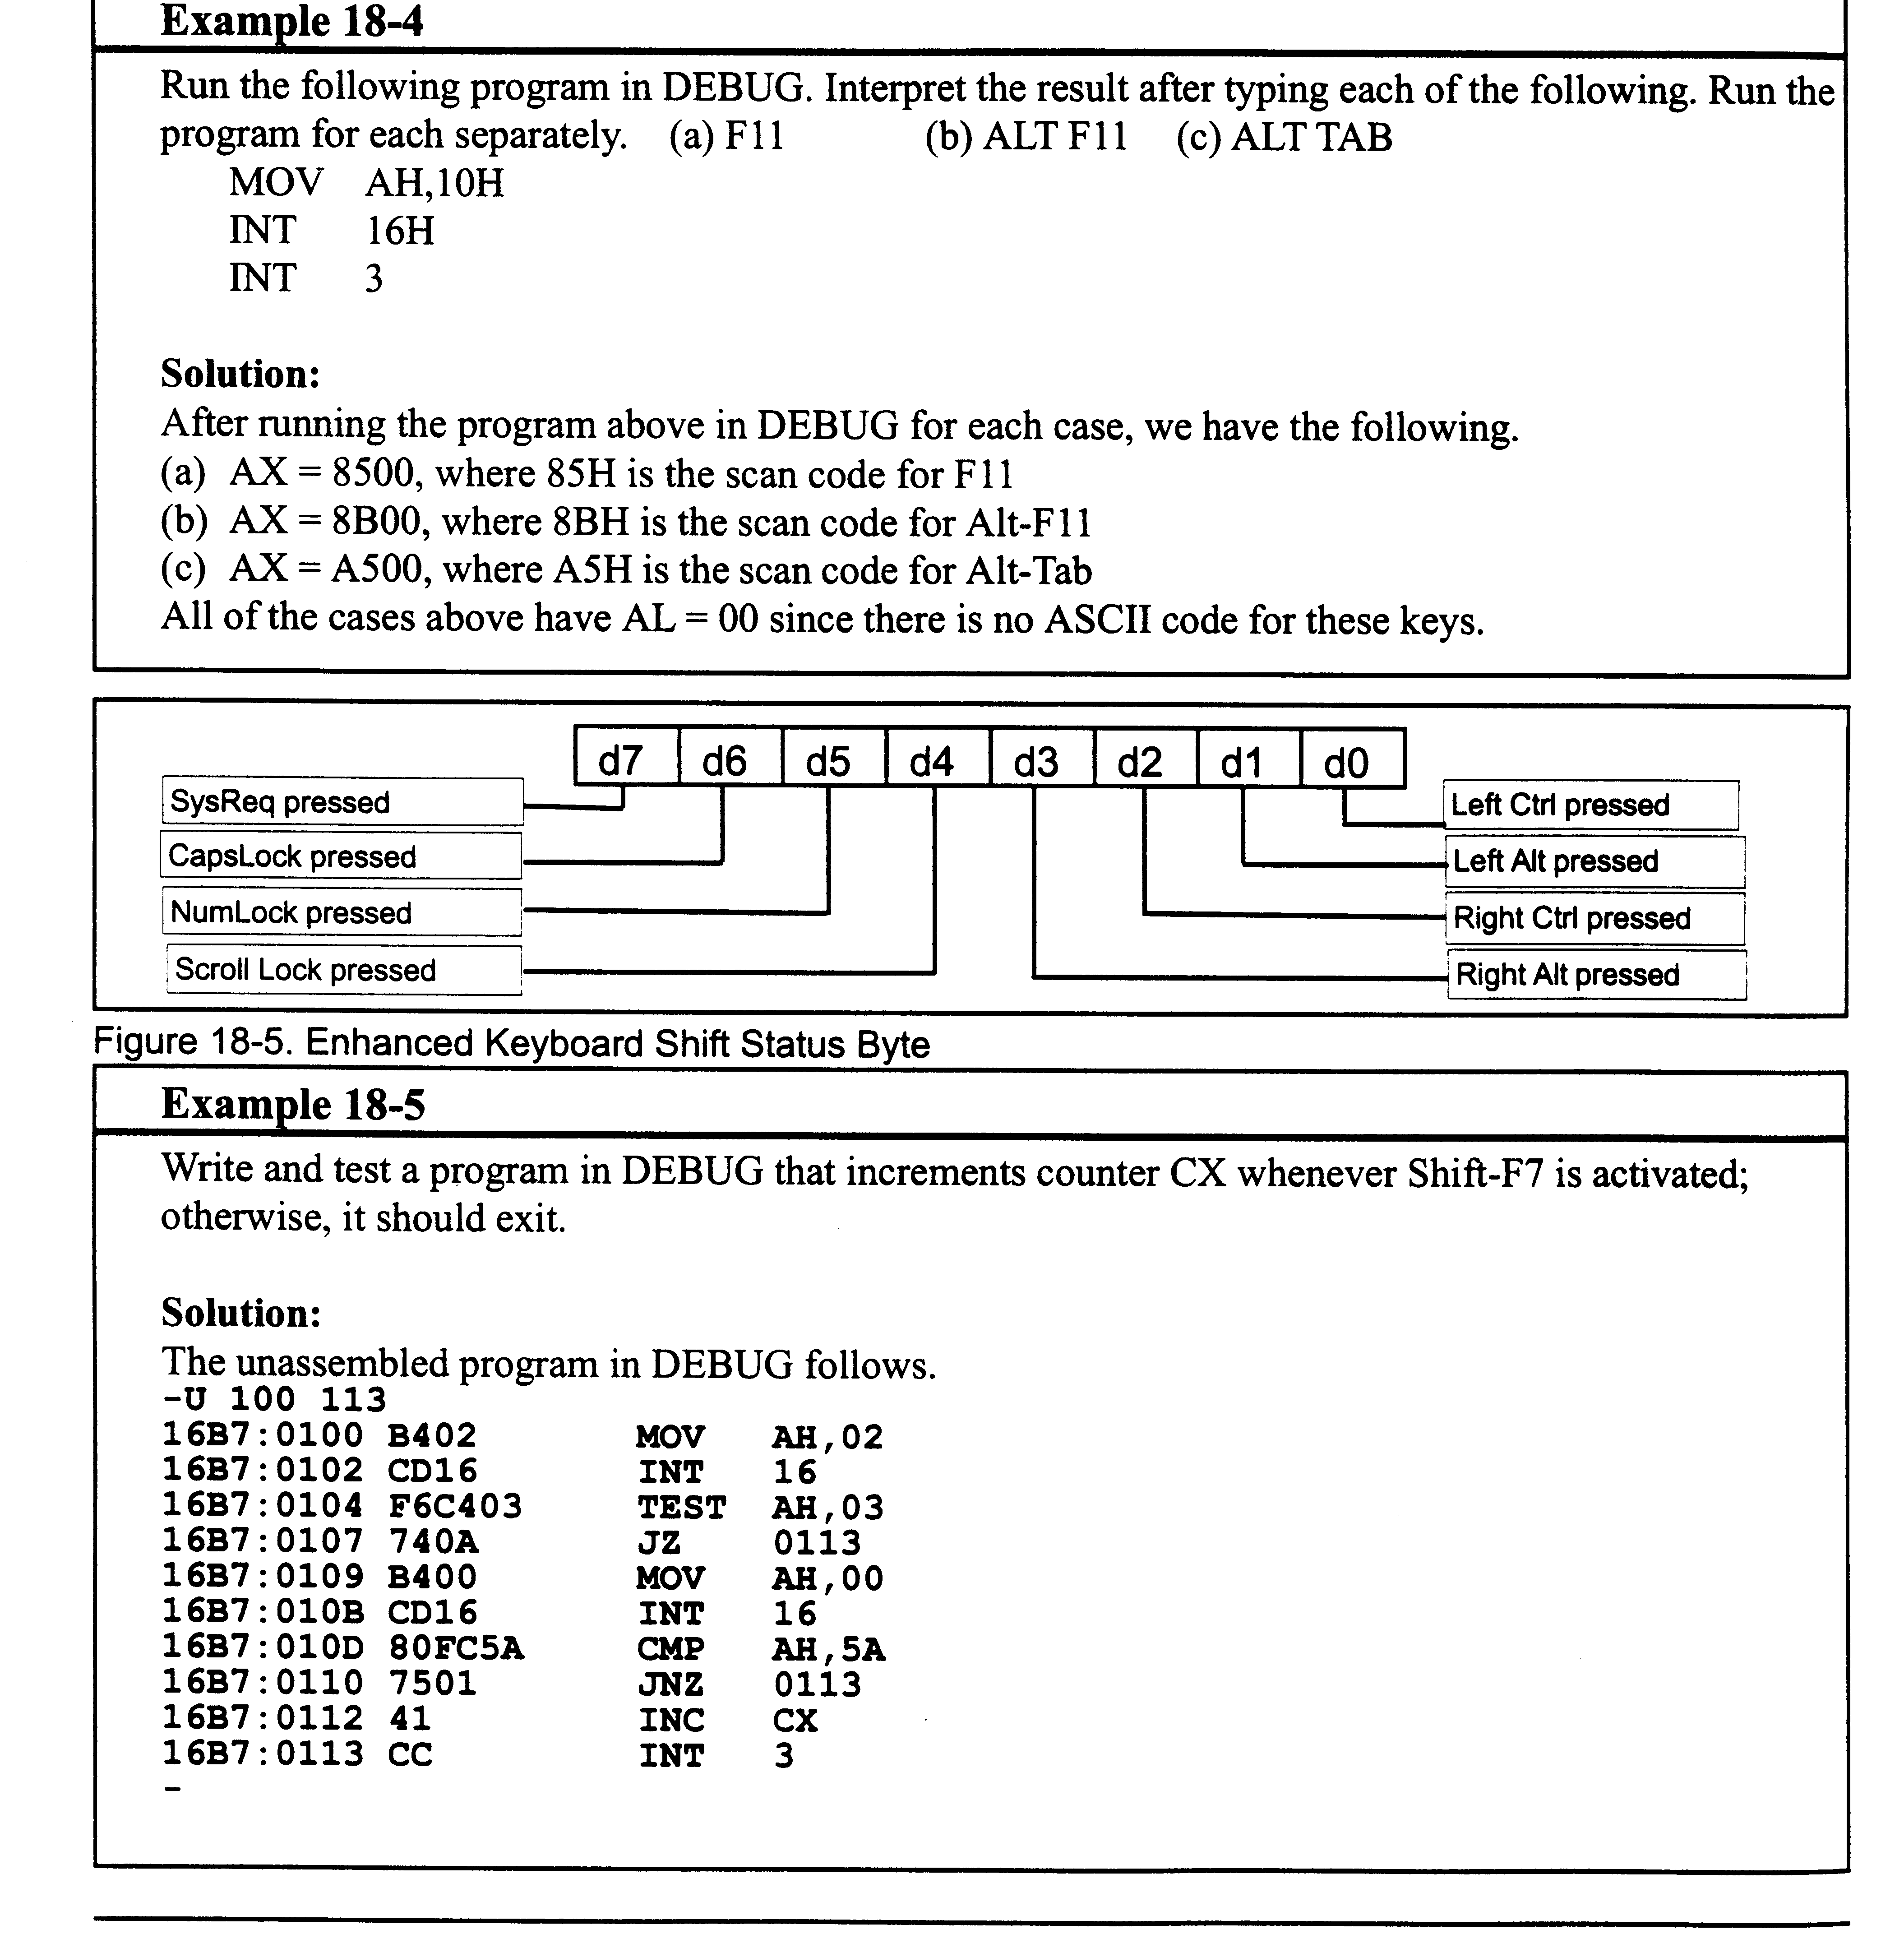
Enhanced Keyboard Shift Status Byte

Slide 25
Using BIOS INT 16H
Keypress ISP is IRQ 01, INT 09, BIOS INT 16H
Functions
  00H – read a character
  01H – find if a character is available
  02H – return keyboard status byte (71H)
  10H – read a character
  11H – find if a character is available
  12H – return the keyboard status byte
    Also provides shift status byte

Slide 26
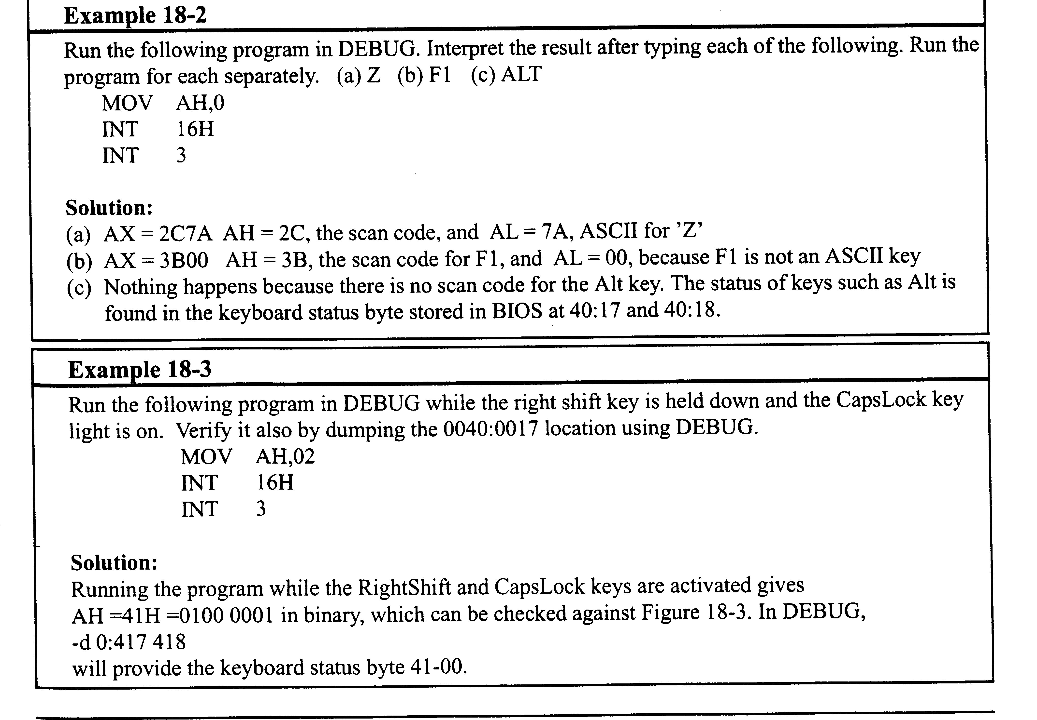
Example 18-2

Slide 27
Example 18-3

Slide 28
Example 18-4

Slide 29
Example 18-5

Slide 30
INT 09 – on press
Keyboard controller scans for a keypress
When keypress, generates INT on IRQ1
ISR reads scan code from port 60H
ISR checks for shift keys
ISR write ASCII (or X’00’) and Scan codes into keyboard buffer
ISR issues EOI to unmask IRQ1
ISR executes an IRET

Slide 31
IRQ 01 – on release
ISR checks to see if x’80’ difference between this scan code and last.
  Can ignore if a break
  May be a new keypress (typematic)

Slide 32
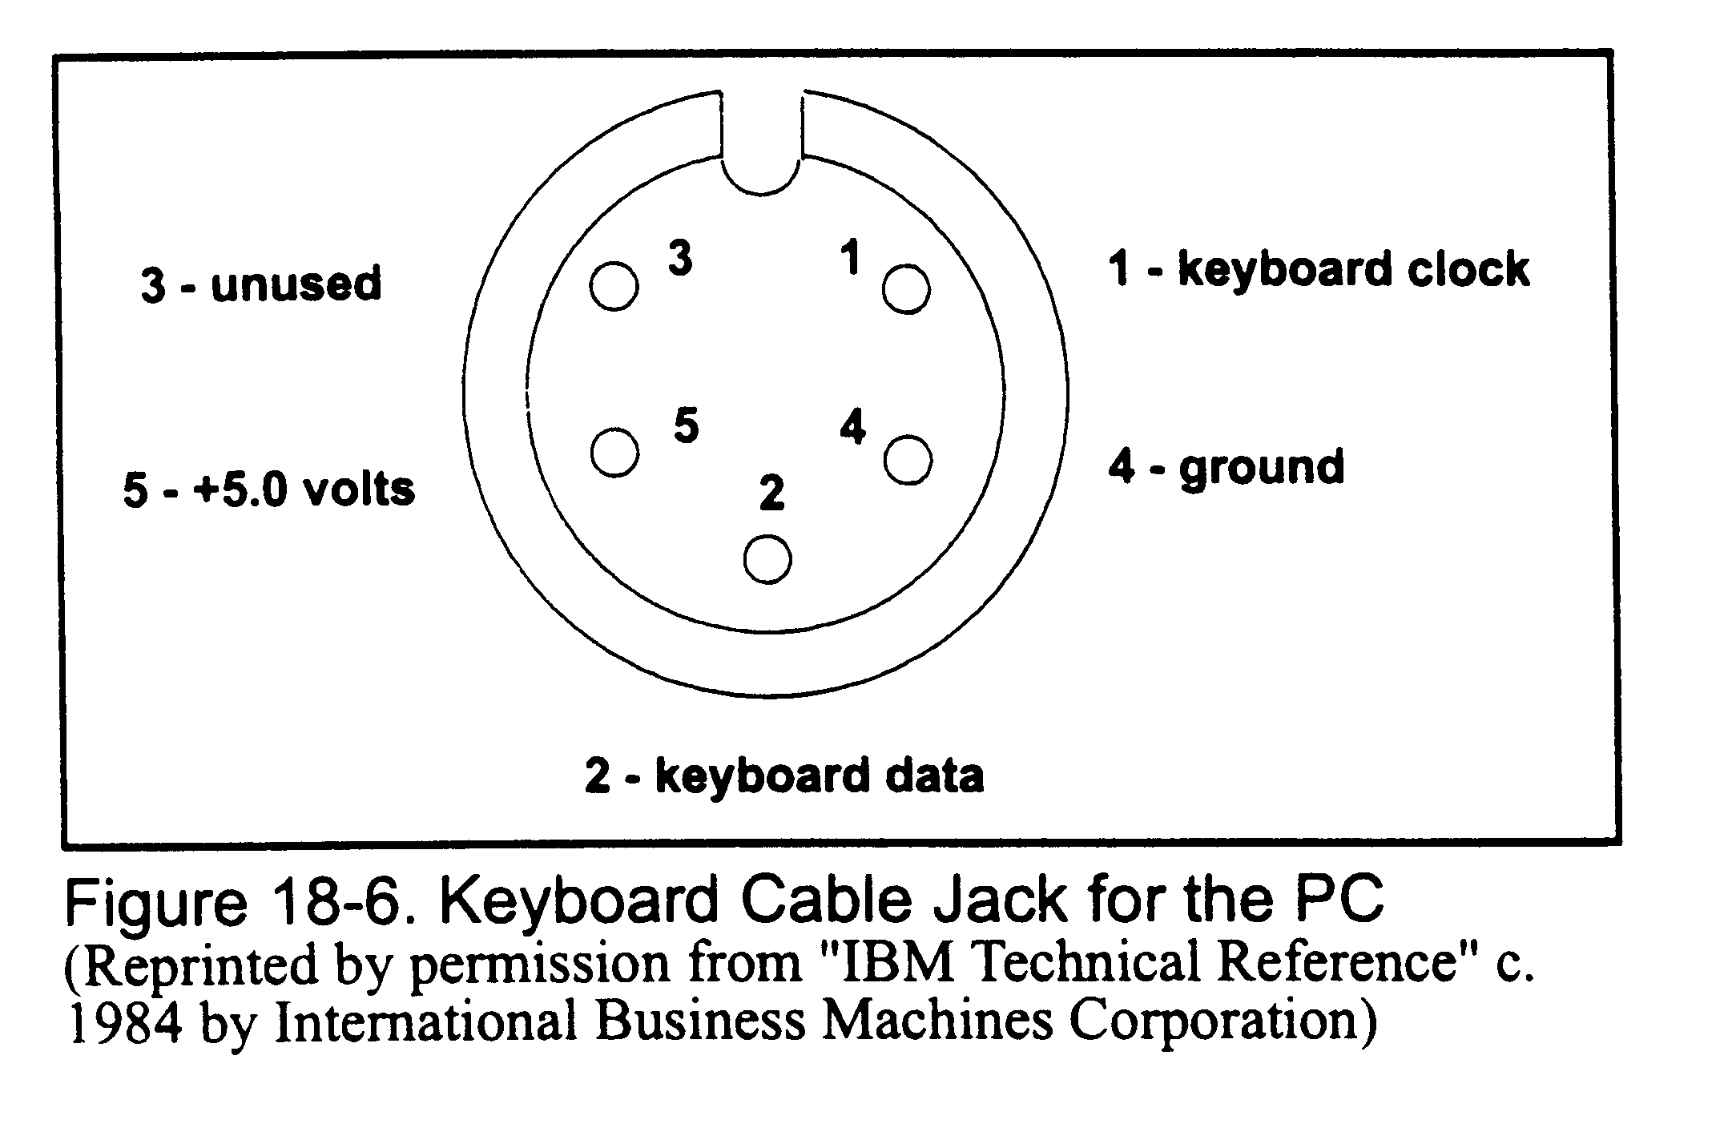
Keyboard Cable Jack

Slide 33
Keyboard Overrun
What happens if the CPU can’t keep up with the typing?
  Overrun error
  Beeps!

Slide 34
Keyboard Buffer
Main memory
Not same as buffer at keyboard end
32 bytes
Starts at 40:001EH
Circular buffer
  Head and tail pointers

Slide 35
Technology
Hard contact
  Physical connect between row and column wires
    Cheap, but wear out quickly
    N o longer used on IBM (except PC jr.)
Soft contact
  Capacitive capacitor at each intersection
  No physical contact

Slide 36
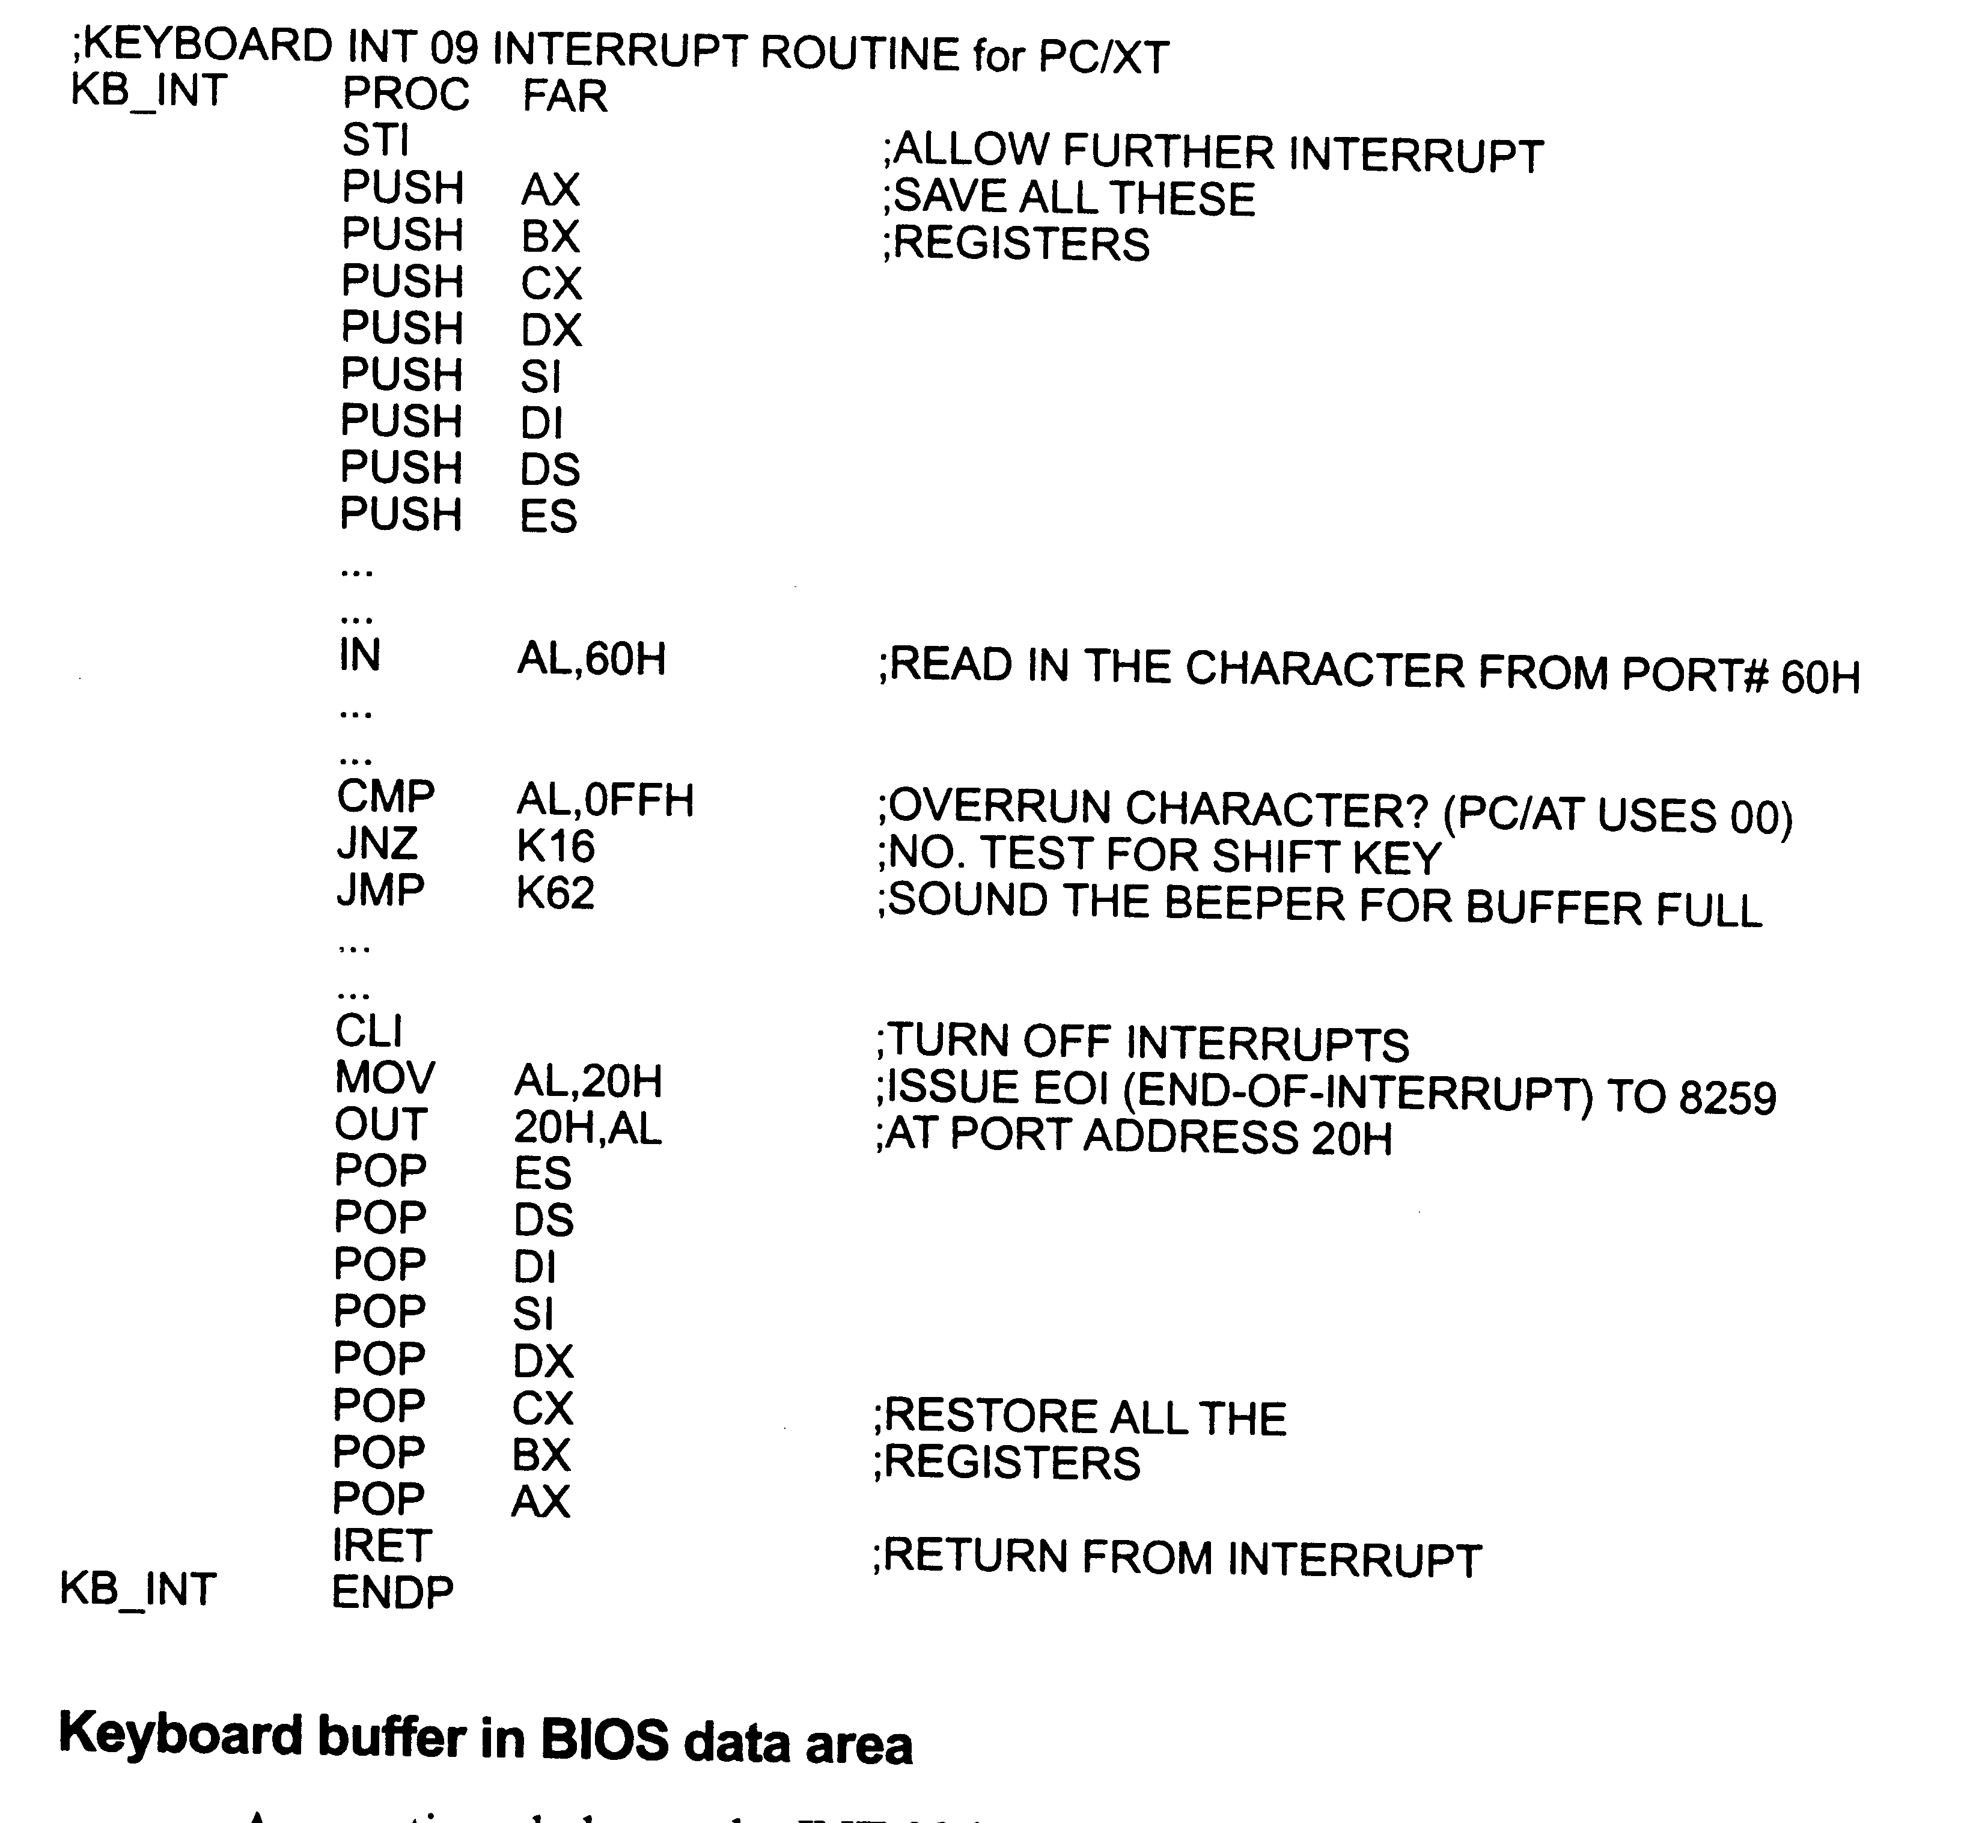
INT 09 ISR

Slide 37
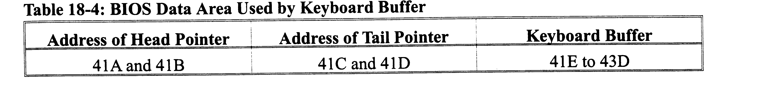
BIOS Data Area for Kbd Buffer

Slide 38
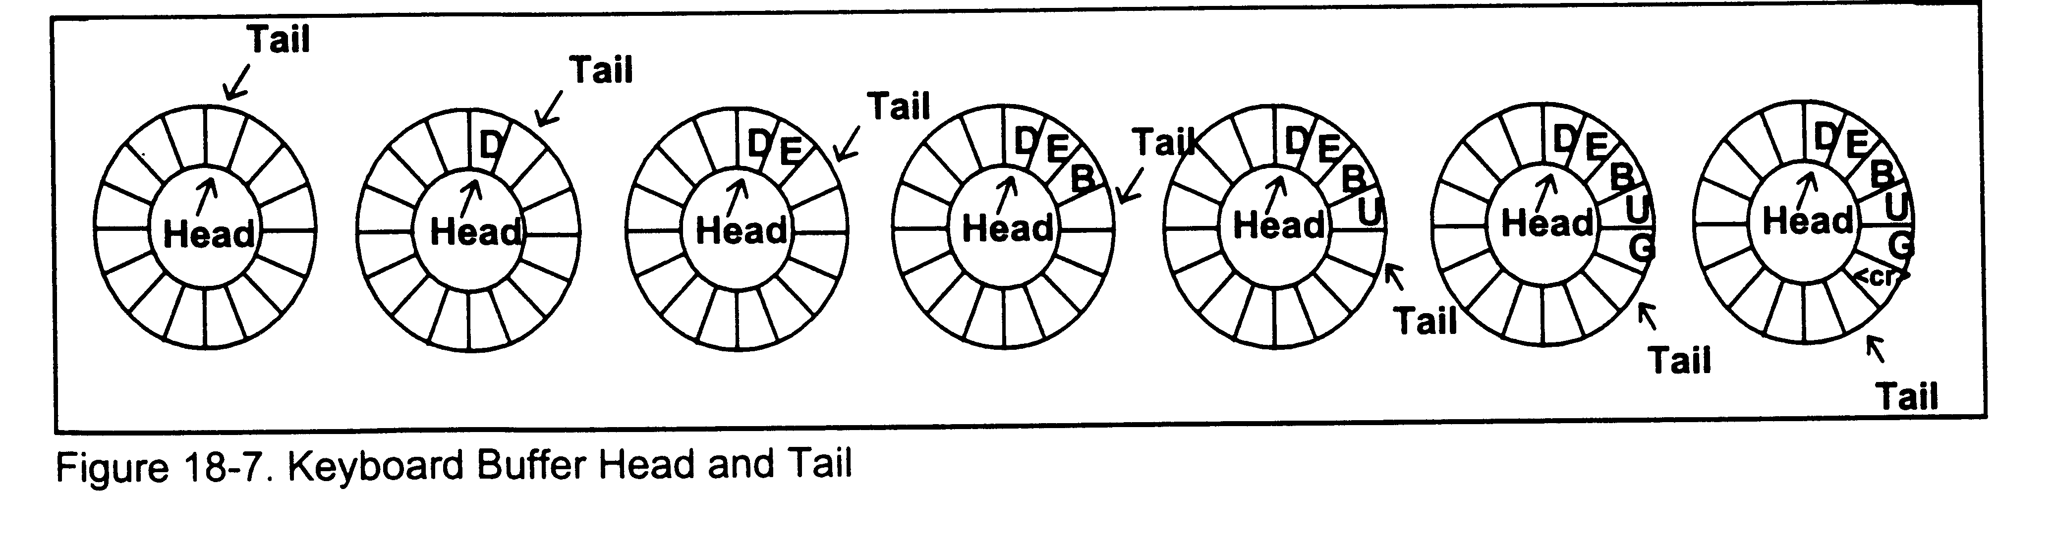
Kbd Buffer Head/Tail Ptrs

Slide 39
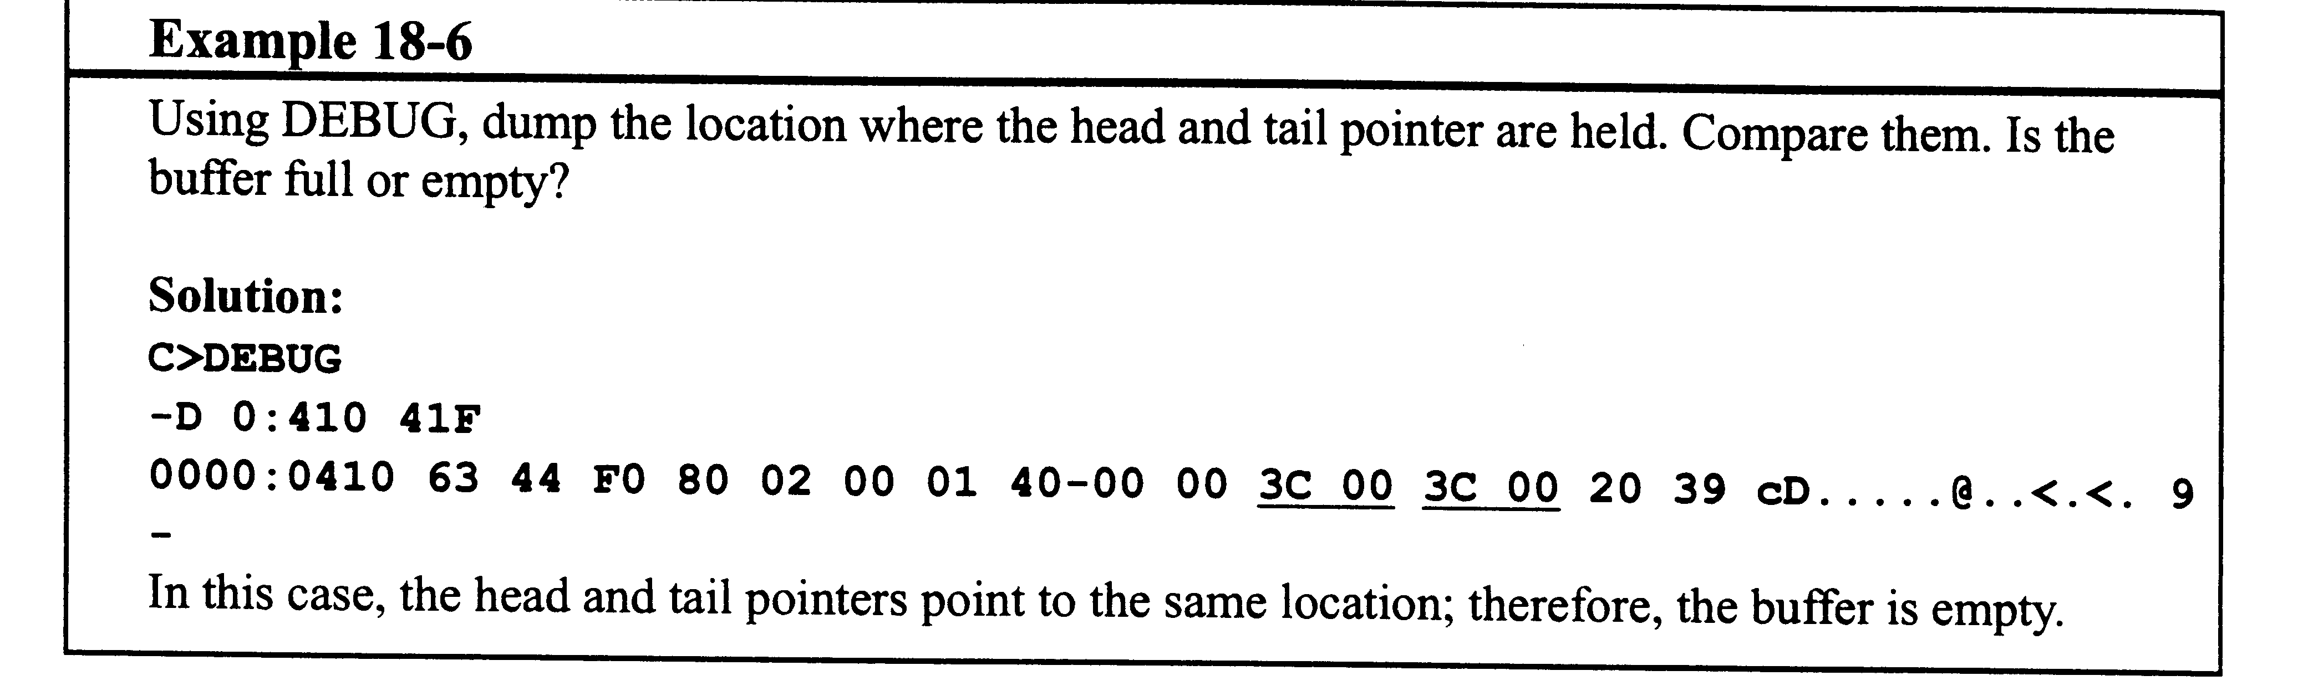
Example 18-6

